Slide 1



Identifying Real-World Data Science Problems
Smit Mevada
Notes:
1

Slide 2




Choosing an Industry Focus
Healthcare
Finance
Patient outcomes, disease prediction.
Fraud detection, market trends.
E-commerce
Customer behaviour, sales forecasting.
Notes:
2

Slide 3

Deep Dive into Healthcare
Key Areas
Predictive diagnostics.
Personalised treatment plans.
Operational efficiency.
Notes:
3

Slide 4

Finance Sector Challenges
Fraud Detection
Identifying suspicious transactions.
Risk Assessment
Evaluating creditworthiness.
Algorithmic Trading
Optimising investment strategies.
Notes:
4

Slide 5

E-commerce Optimisation
Customer Insights
Purchase patterns analysis.
Recommendation engines.
Churn prediction.
Notes:
5

Slide 6








Data Science Problem Lifecycle
Problem Definition
Data Collection
Clearly define the issue.
Gather relevant datasets.
Deployment & Monitoring
Analysis & Modelling
Implement solutions, track performance.
Build predictive models.
Notes:
6

Slide 7
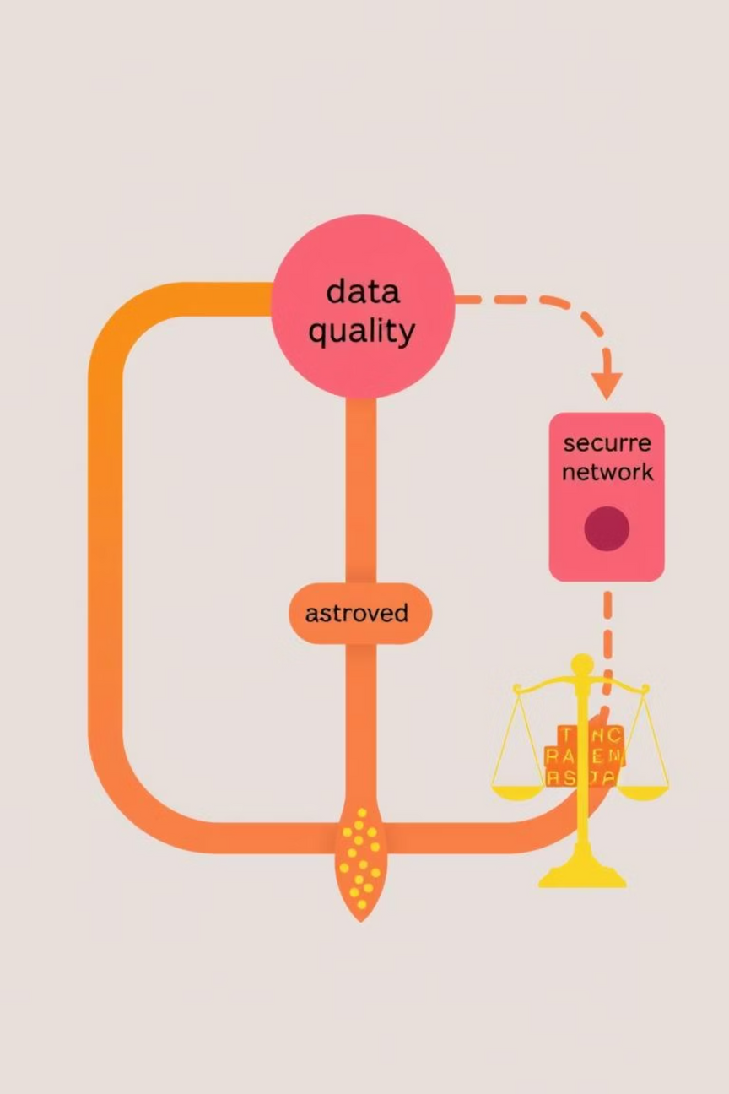
Key Considerations for Success
Data Quality
Domain Expertise
Accurate, complete data is crucial.
Industry knowledge enhances solutions.
Ethical AI
Fairness, transparency, privacy.
Notes:
7

Slide 8

Next Steps: Actionable Insights
Select a specific industry problem.
Formulate a clear problem statement.
Identify necessary data sources.
Begin initial data exploration.
Notes:
8

